Slide 1
Indian Agriculture Analysis
Saher Sohail

Slide 2
Introduction
Agricultural analysis is crucial for ensuring food security, promoting economic development, managing resources sustainably, adapting to climate change, informing policy-making, fostering rural development, and providing market intelligence.

Slide 3
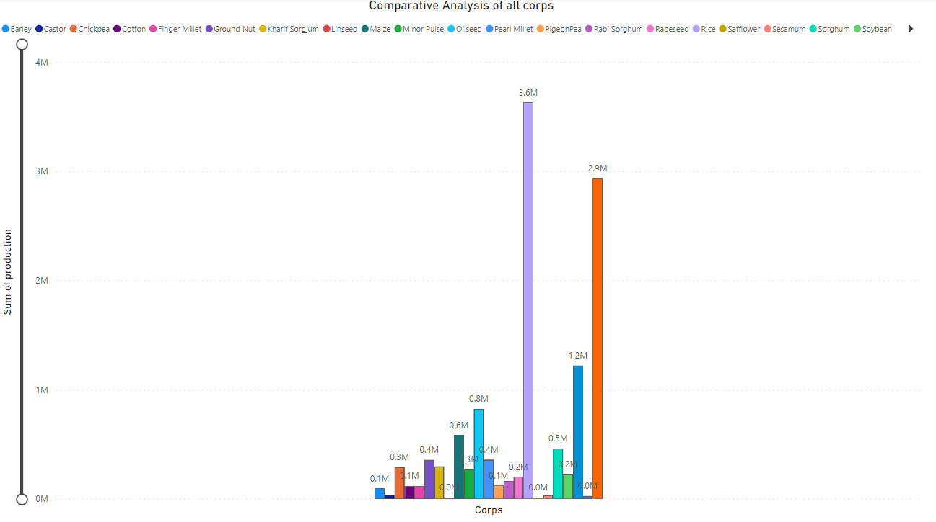
Overall Crop Production

Slide 4
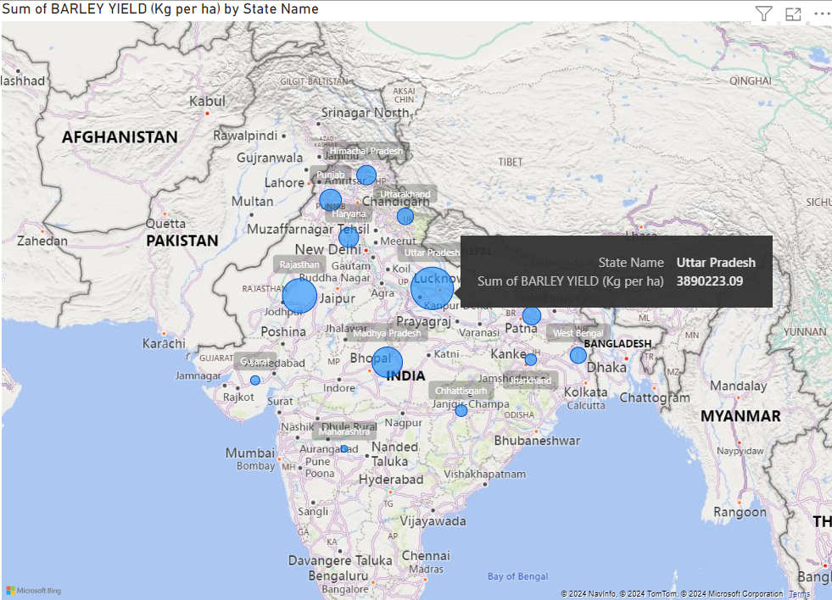
Barley yielded by state

Slide 5
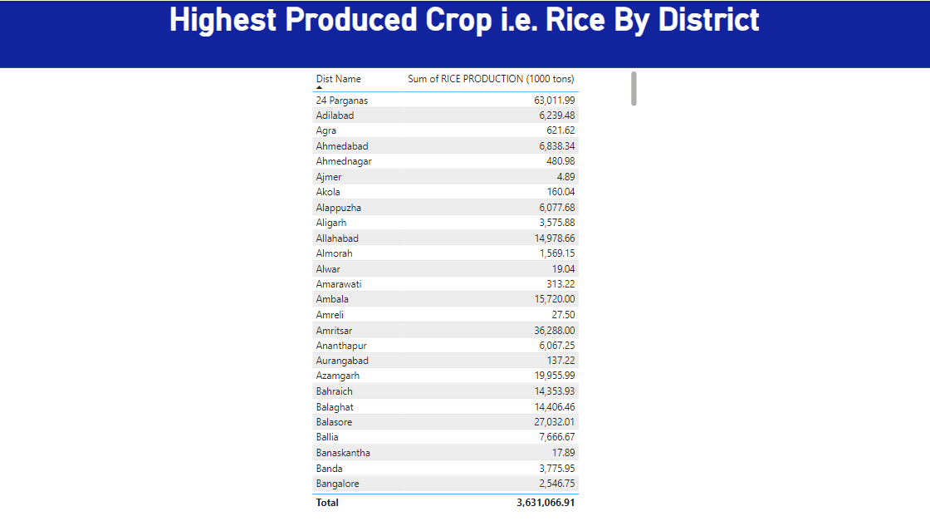
Highest Crop Production by each District

Slide 6
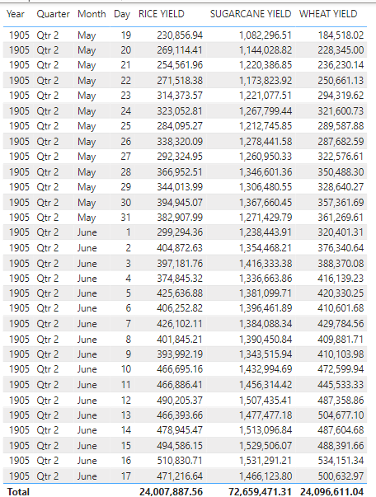
Highest three corps yielded over time

Slide 7
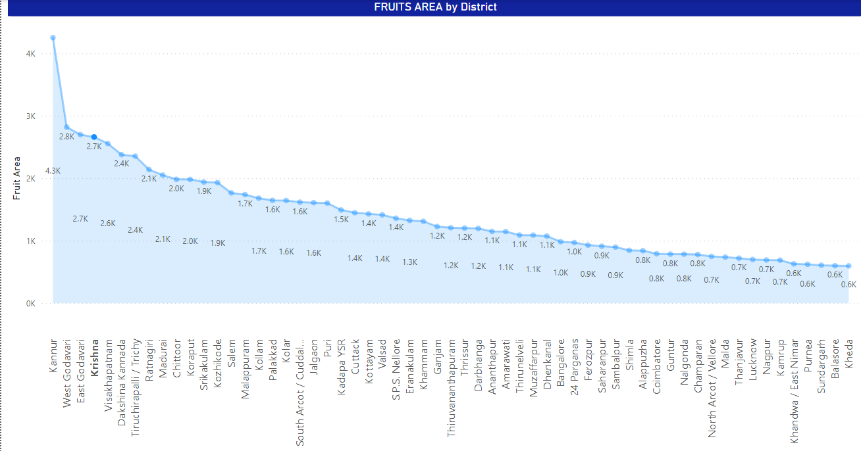
Fruit Area By District

Slide 8
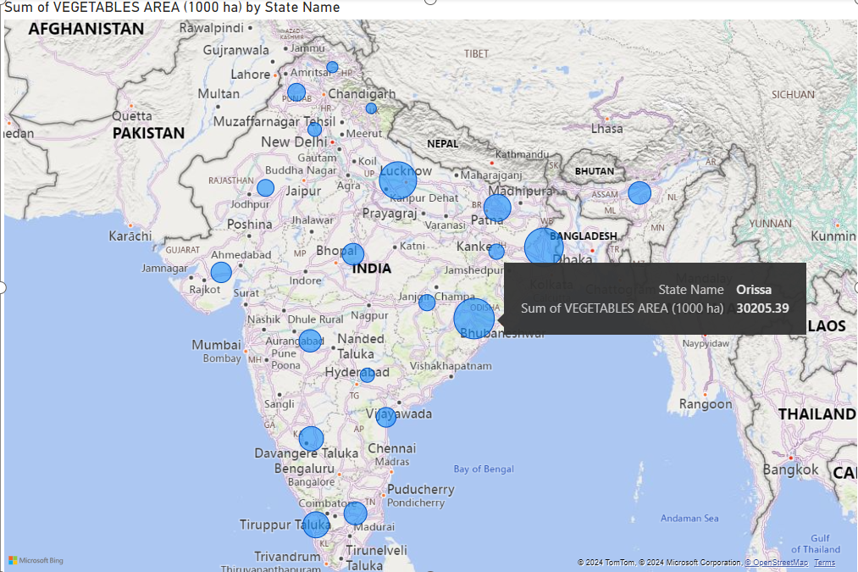
Veg Area By State

Slide 9
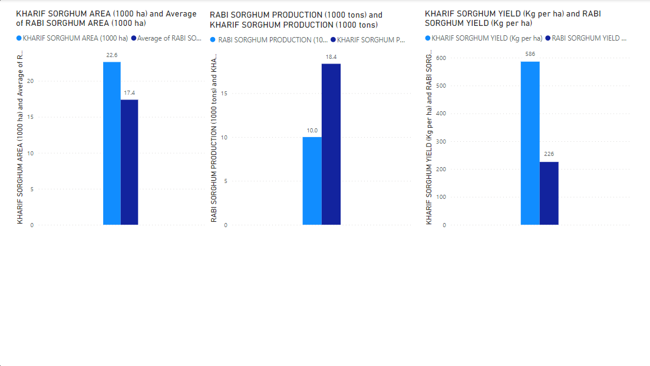
Karif x Rabi

Slide 10
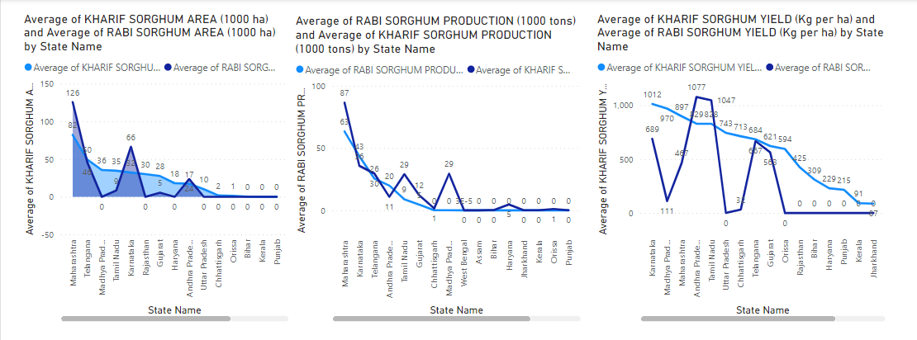
Karif x Rabi by state

Slide 11
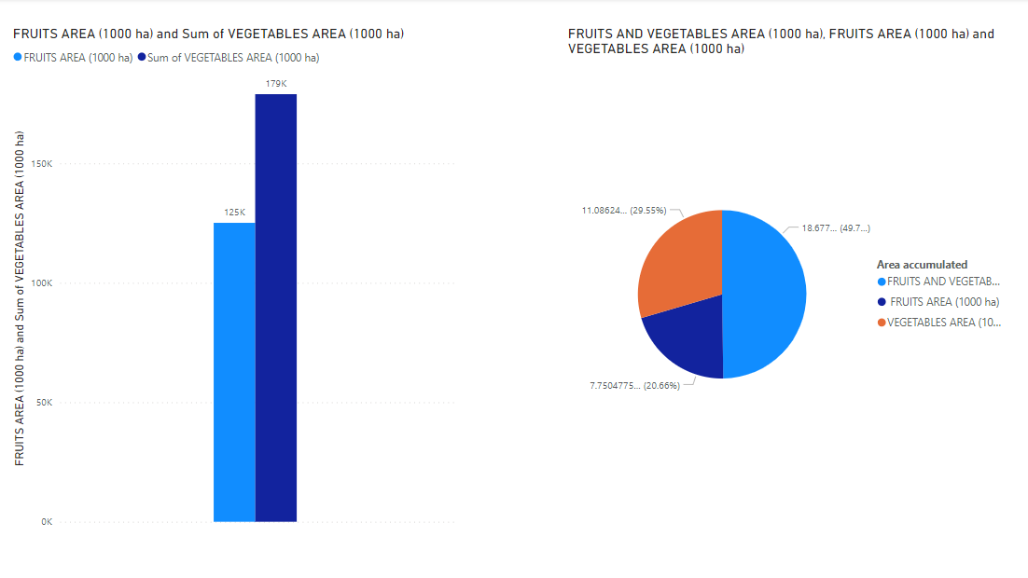
Fruit and Vegetable area

Slide 12
Thank you
Saher Sohail
khansahersohail@gmail.com

